Slide 1
Undecided grabber mechanism
Undecided grabber mechanism

Slide 8
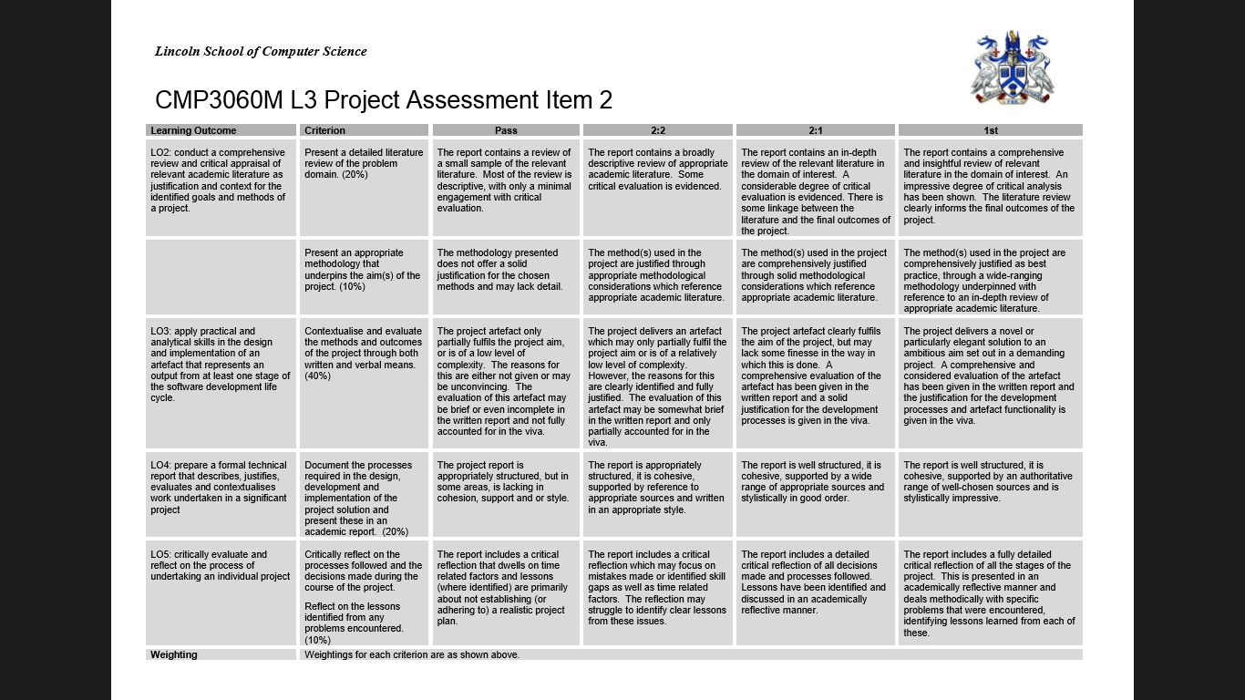

Slide 9
Relative
Geo-Position
System
Background
Extraction
Robot
▲
Frames
▲
Objects
▲
Instruction
Background
▼
Position
▼
Download
Updates
Data
Storage
Robot
Handler
Camera
◄ Frames
Frame +BG ►
Instructions ►
▲
Frame
▲
Labelled Objects
BG + Frame
▼
Image Stream
▼
Foreground
Extraction
System
Raspberry Pi
Server
Google
Vision API
Frame ►
◄ Labels
Object ►

Slide 10
Camera Group
Instructions Group
Instructions
Robot Handler 1
Instructions
Robot 1-A
Camera
Snapshot
ImageStore
Instructions
Robot 2-A
Server
Instructions Group
Instructions
Robot Handler 2
Instructions
Robot 2-B
Camera Group
Camera
Snapshot
ImageStore
Instructions
Robot 2-C

Slide 11
Instructions Group
Instructions Group
Camera
Snapshot
Server
Robot Handler
Robot
Instructions
Instructions
ImageStore

Slide 12
Task List
Functions:
Image Acquisition
Image Store Replace
Background Generation
Foreground Extraction
Object Identification
Trash Label Filter
Relative Geo-Position
Find Trash positions
Find Robot position
Calculate Rotation Required
Calculate Distance Required
Robot Instruction Generation
Robot Communication
Other:
Buy RC Car
Set up frame store to system handler connection
Set up System handler to Robot handler connection

Slide 14
0 | 3 | 1 | 1 | 3 | 0 | 3 | 1 | 3
0 | 0 | 1 | 1 | 1 | 3 | 3 | 3 | 3
Med: | 1
Mode: | 3
Mean: | 1.66

